Slide 1
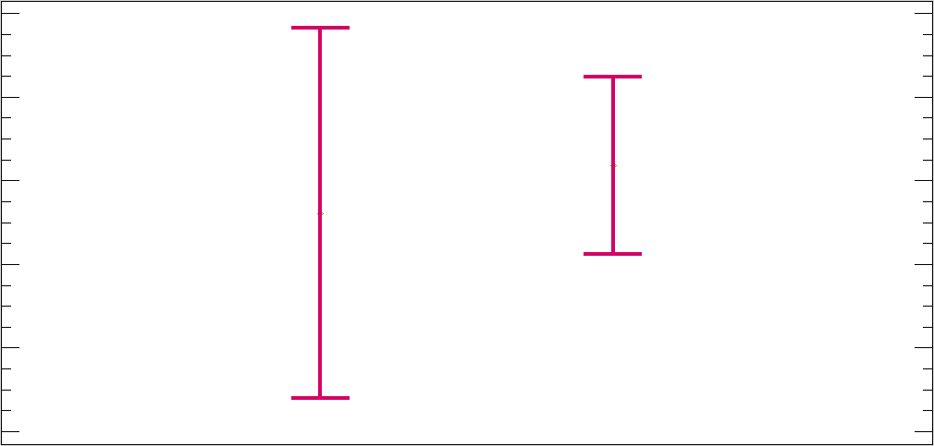

Medias & 95% of Fisher´s LSD
1,91
1,89
1,87
$$\sqrt[4]{YearsCode}$$
1,85
1,83
1,81
Portugal
Spain
Country

